Slide 1

.Net – made easy
Florin Rotaru

Slide 2
What are we going to talk about
A real life example – how do we make choices
Should I learn .NET, C#?
.NET Core templates

Slide 3
A real life example - how do we make choices

Slide 4
Should I learn .NET, C#?

Slide 5

Should I learn .NET, C#?
Cloud
https://docs.servicestack.net/netcore-windows-desktop
https://dev.to/nishthasinghuk/check-out-avalonia-a-cross-platform-user-interface-toolkit-for-the-net-core--g9j
IoT
Build apps that run on
Raspberry Pi, MinnowBoard MAX,
DragonBoard 410c, and more
https://dotnet.microsoft.com/apps/iot
Mobile
Xamarin
https://dotnet.microsoft.com/apps/mobile
Web
ASP.NET Core MVC
https://docs.microsoft.com/en-us/aspnet/core/tutorials/first-mvc-app/?view=aspnetcore-2.2
Gaming
Unity : Developing Your First Game with Unity and C#
https://msdn.microsoft.com/en-us/magazine/dn759441.aspx

Slide 6
Should I learn .NET, C#?
Free
Cross-platform
Open Source
https://dotnet.microsoft.com/

Slide 7
Should I learn .NET, C#?
Google search:
Popularity of programming languages
http://pypl.github.io/
https://insights.stackoverflow.com/survey/2018/#technology
Worldwide, Feb 2019 compared to a year ago:
Rank | Change | Language | Share | Trend
1 |  | Python | 26.42% | 5.20%
2 |  | Java | 21.20% | -1.30%
3 |  | Javascript | 8.21% | -0.30%
4 |  | C# | 7.57% | -0.50%

Slide 8
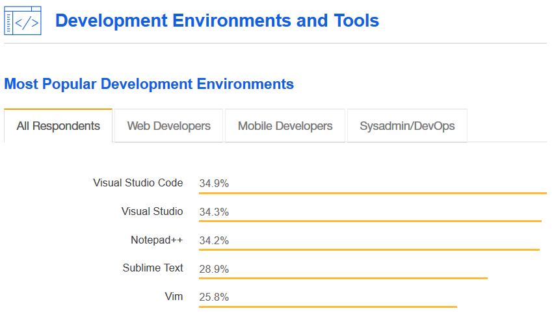
Should I learn .NET, C#?
https://insights.stackoverflow.com/survey/2018/#development-environments-and-tools

Slide 9
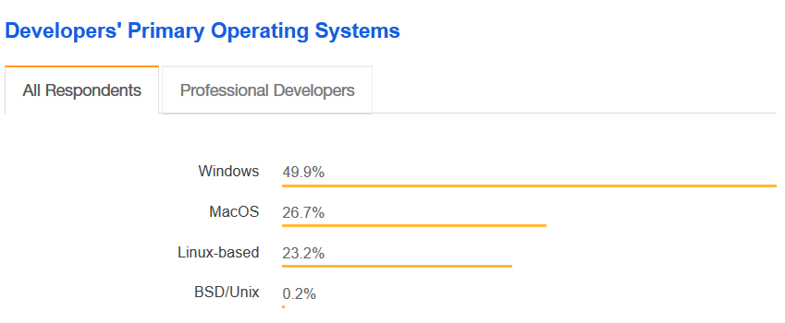
Should I learn .NET, C#?
https://insights.stackoverflow.com/survey/2018/#technology-developers-primary-operating-systems

Slide 10
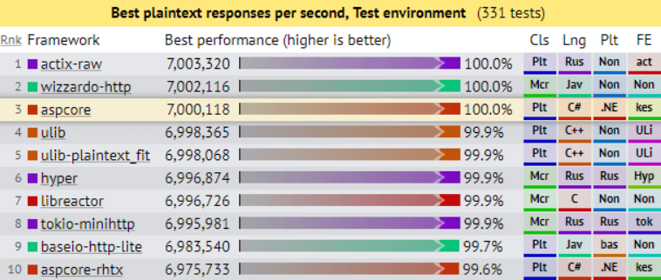
Performance
Should I learn .NET, C#?
ASP.NET Core: Saturating 10GbE at 7+ million request/s
Citrine” Environment: 14 Core, 28 HT, 32 GB RAM
https://benchmarksgame-team.pages.debian.net/benchmarksgame/faster/go-csharpcore.html
https://www.ageofascent.com/2019/02/04/asp-net-core-saturating-10gbe-at-7-million-requests-per-second/

Slide 11
Experience
Should I learn .NET, C#?
Microsoft started development on the .NET Framework in the late 1990s originally under the name of Next Generation Windows Services (NGWS). By late 2001 the first beta versions of .NET 1.0 were released.^{[1]} The first version of .NET Framework was released on 13 February 2002, bringing managed code to Windows NT 4.0, 98, 2000, ME and XP.
.Net (R)evolution
https://en.wikipedia.org/wiki/.NET_Framework_version_history

Slide 12
Continues to improve over time
Should I learn .NET, C#?

Slide 13
Easy to learn
Should I learn .NET, C#?
NET In-Browser Tutorial
Udemy
…

Slide 14
Costs
Should I learn .NET, C#?
For individuals
Any individual developer can use Visual Studio Community to create their own free or paid apps.
For organizations
An unlimited number of users within an organization can use Visual Studio Community for the following scenarios: in a classroom learning environment, for academic research, or for contributing to open source projects.
For all other usage scenarios: In non-enterprise organizations, up to five users can use Visual Studio Community. In enterprise organizations (meaning those with >250 PCs or >$1 Million US Dollars in annual revenue), no use is permitted beyond the open source, academic research, and classroom learning environment scenarios described above.

Slide 15
NET Core templates Live Demo

Slide 16
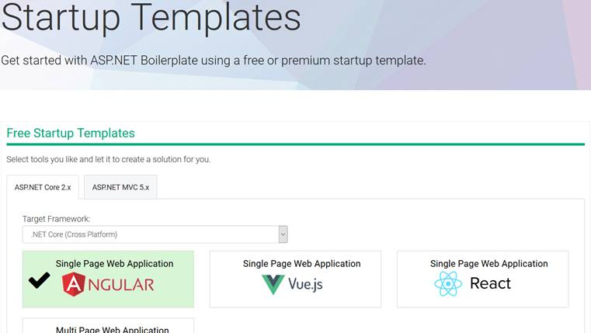
https://aspnetboilerplate.com/Templates

Slide 17
Take away
It is easy to learn
It is fast
It is popular
It is Free, Open Source and Cross-Platform
It is well paid

